Slide 1
MySQL

Slide 2
Outline
Introduce MySQL
Entity Relationship
Relational Database Schema
Syntax of SQL statement
SQL Data Types
Constraints SQL

Slide 3
Introduce MySQL
1

Slide 4
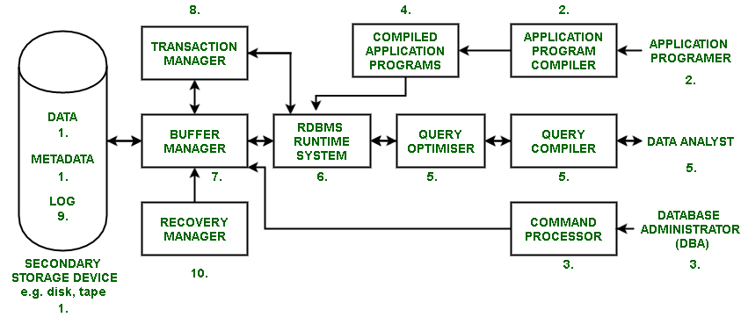
*Database: is a separate application that stores a collection of data. Each database has one or more distinct APIs for creating, accessing, managing, searching and replicating the data it holds.
*A Relational DataBase Management System (RDBMS) is a software that
- Enables you to implement a database with tables, columns and indexes.
- Guarantees the Referential Integrity between rows of various tables.
- Updates the indexes automatically.
- Interprets an SQL query and combines information from various tables.
Notes:
Sửa lại ảnh

Slide 5

*MySQL: is a fast, easy-to-use RDBMS being used for many small and big businesses. MySQL is developed, marketed and supported by MySQL AB.
* MySQL is becoming so popular because:
MySQL is released under an open-source license
MySQL is a very powerful program in its own right
MySQL uses a standard form of the well-known SQL data language
MySQL works on many operating systems and with many languages including PHP, PERL, C, C++, JAVA, etc.
MySQL works very quickly and works well even with large data sets
MySQL is very friendly to PHP, the most appreciated language for web development.
MySQL supports large databases, up to 50 million rows or more in a table
Notes:
Sửa lại ảnh

Slide 6
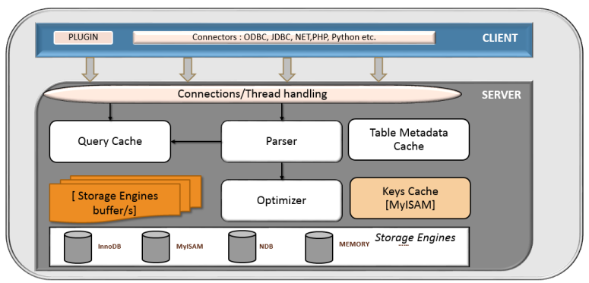
MySQL Architecture
Notes:
https://www.geeksforgeeks.org/architecture-of-mysql/
https://viblo.asia/p/tim-hieu-mysql-architecture-RnB5pj9JZPG

Slide 7
The Architecture of MYSQL contain following major layer’s: Client, Server, Storage Layer
Client Layer: Utility to connect MySQL server
- Connection Handling, Authentication, Security.
Server Layer: responsible for all logical functionalities RDBMS
- Thread Handling
- Parser
- Optimizer
- Cache
Storage Layer: InnoDB ,MYISAM , NDB ,Memory
Notes:
https://lalitvc.wordpress.com/2016/11/03/mysql-architecture-and-components/

Slide 8
 | MySQL | SQL server
Developers | Oracle | Microsoft
Nature | Multi language (PHP) | .NET
Cost | General Public License | Buy license
Storage engines | Many different storage engines (InnoDB and MyISAM) | A storage engine developed from Microsoft
IDE | Enterprise Manager | Management Studio

Slide 9
Entity Relationship
2

Slide 10
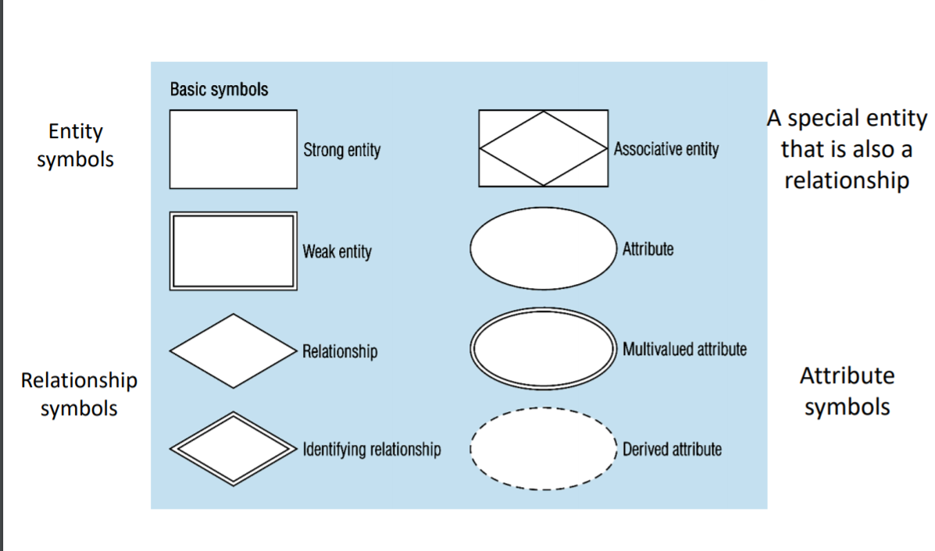
An entity relationship diagram (ERD) shows the relationships of entity sets stored in a database.
This model is based on three basic concepts:
- Entities (objects)
- Attributes (properties)
- Relationships
Notes:
https://www.smartdraw.com/entity-relationship-diagram/

Slide 11
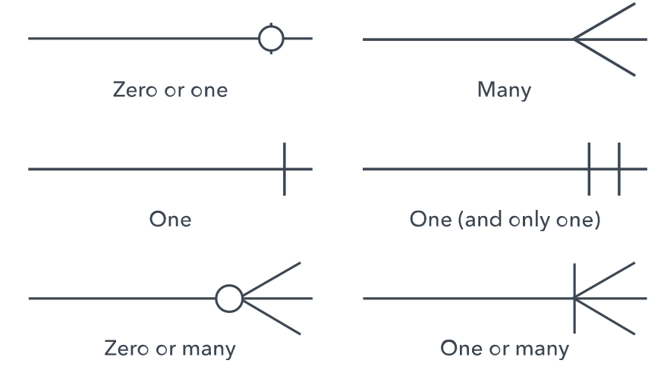
Have three main relationship:
- 1 – 1 relationship
- 1 – n relationship
- n – n relationship
https://erdplus.com/
Sign

Slide 12
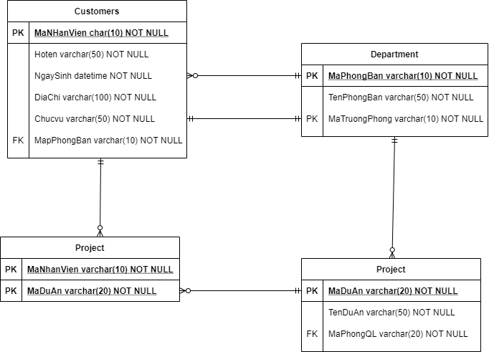

Slide 13
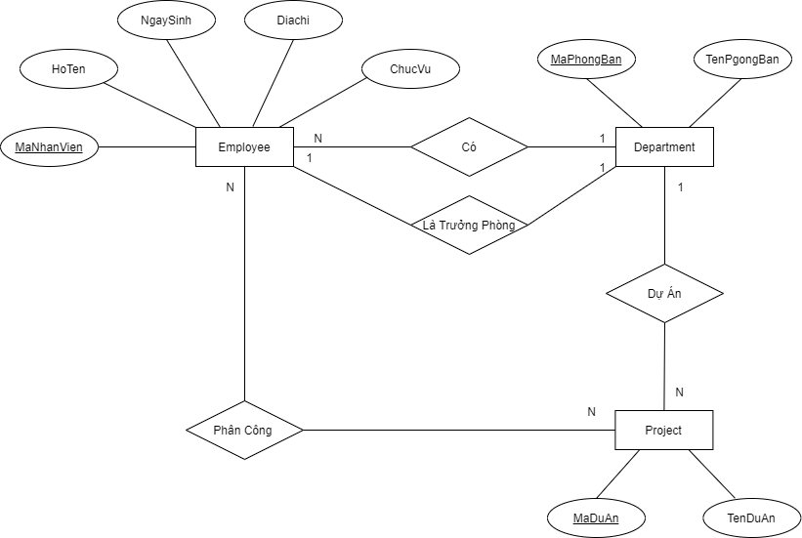

Slide 14
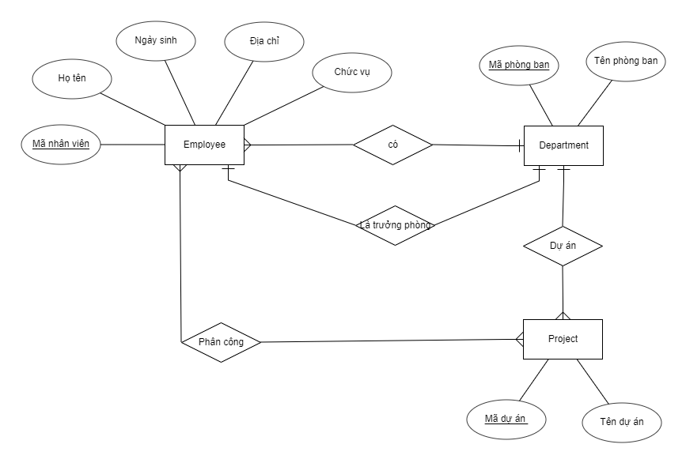

Slide 15
Relational Database Schema
3

Slide 16
A relational schema for a database is an outline of how data is organized. It can be a graphic illustration, or another kind of chart used by programmers to understand how each table is laid out, including the columns and the types of data they hold and how tables connect
Components of Relational schema:
- Table
- Primary Key
- Foreign Key
Notes:
Sửa lại ảnh

Slide 17
Convert from ERD to Relational Database schema:
Rule:
Step 1: Convert each entity type into a corresponding relation type:
+ 1 to 1 relationship: two entities into one entity
+ 1 - N relationship: get the multi-entity side key convert to foreign key
+ N - N relationship: form a new kind of relationship
Step 2: Check the standard form of the relationships

Slide 18
Convert from ERD to Relational Database schema:

Slide 19
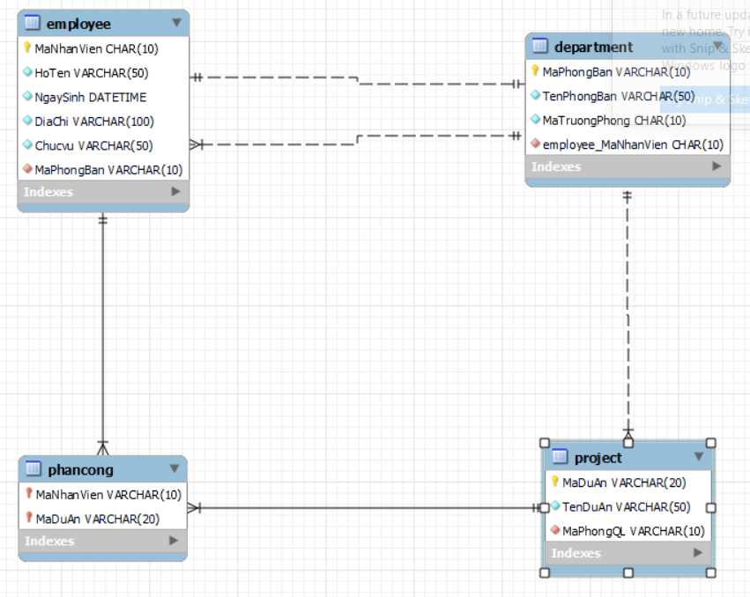

Employee(MaNhanVien, HoTen, NgaySinh, DiaChi,ChucVu, MaPhongBan)
Department(MaPhongBan, TenPhongBan, MaTruongPhong)
Project(MaDuan, TenDuan, MaPhongQL)
Phancong(MaNhanVien, MaDuan)

Slide 20
Syntax of SQL Statement
4

Slide 21
DDL (Data Definition Language) is a syntax for creating and modifying database objects such as tables, indices, and users.
CREATE, ALTER, DROP, RENAME
DML (Data Manipulation Language)
INSERT, UPDATE, DELETE
DQL (Data Query Language)
SELECT
DCL (Data Control Language)
GRANT, REVOKE
TCL (Transaction Control Language)
COMMIT, ROLLBACK, SAVEPOINT
Notes:
https://www.geeksforgeeks.org/sql-ddl-dql-dml-dcl-tcl-commands/
https://www.javatpoint.com/dbms-sql-command

Slide 22
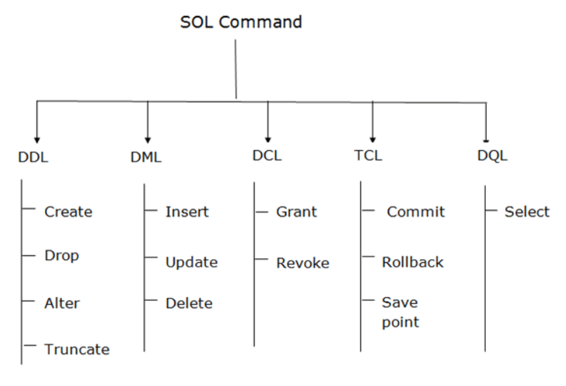
Notes:
https://www.geeksforgeeks.org/sql-ddl-dql-dml-dcl-tcl-commands/
https://www.javatpoint.com/dbms-sql-command

Slide 23
DCL (Data Control Language) are used to grant and take back authority from any database user.
GRANT: It is used to give user access privileges to a database.
REVOKE: It is used to take back permissions from the user.
TCL (Transaction Control Language)
COMMIT: Commit command is used to save all the transactions to the database.
ROLLBACK: Rollback command is used to undo transactions that have not already been saved to the database.
SAVEPOINT: It is used to roll the transaction back to a certain point without rolling back the entire transaction.
Notes:
https://www.geeksforgeeks.org/sql-ddl-dql-dml-dcl-tcl-commands/
https://www.javatpoint.com/dbms-sql-command

Slide 24


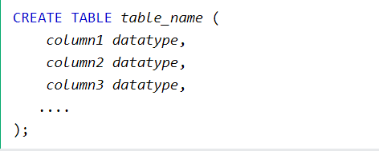

Create Database:
Drop Database:
Create Table:
Drop Table:
Notes:
Sửa lại ảnh

Slide 25




Alter Table: is used to add, delete, or modify columns in an existing table.
- ADD column:
- DROP column:
- ALTER/MODIFY column:
+ SQL server:
+ MySQL:

Slide 26
DELETE | TRUNCATE | DROP
Xoá 1 hay nhiều bản ghi trong bảng | Xoá toàn bộ dữ liệu các bản ghi trong bảng. | Xóa luôn bảng và dữ liệu khỏi Database
DML | DDL | DDL
Dữ liệu có thể phục hồi | Không | Không
DELETE FROM table_name [WHERE conditions] | TRUNCATE TABLE table_name; | DROP TABLE table_name;

Slide 27
SQL Data Types
5

Slide 28
In MySQL there are three main data types: string, numeric, date and time.
https://www.w3schools.com/sql/sql_datatypes.asp
String Data Types:
- CHAR(size): A FIXED length string
- VARCHAR(size): A VARIABLE length string
- NVARCHAR(size)
- BINARY(size)
- TEXT

Slide 29
Numeric Data Types:
- INT(size)
- BIT(size)
- FLOAT
- DECIMAL
- BOOL
Date and Time Data Types:
- DATE: YYYY-MM-DD
- DATETIME: YYYY-MM-DD hh:mm:ss
- TIME: hh:mm:ss
- YEAR

Slide 30
Constraint MySQL
6

Slide 31
SQL constraints are used to specify rules for the data in a table.
Constraints are used to limit the type of data that can go into a table. This ensures the accuracy and reliability of the data in the table
The following constraints are commonly used in SQL:
- NOT NULL - Ensures that a column cannot have a NULL value
- UNIQUE - Ensures that all values in a column are different
- PRIMARY KEY - A combination of a NOT NULL and UNIQUE. Uniquely identifies each row in a table
- FOREIGN KEY - Prevents actions that would destroy links between tables
- CHECK - Ensures that the values in a column satisfies a specific condition
- DEFAULT - Sets a default value for a column if no value is specified
- CREATE INDEX - Used to create and retrieve data from the database very quickly

Slide 32
AUTO_INCREMENT allows a unique number to be generated automatically when a new record is inserted into a table.
- MySQL: AUTO_INCREMENT
Example: primary key, int
- SQL Server: IDENTITY(start, increment)
Example: start, increment
https://www.w3schools.com/sql/sql_autoincrement.asp
CREATE TABLE
Demo
Notes:
https://www.w3schools.com/sql/sql_autoincrement.asp

Slide 33
Thanks!
Any questions ?

